Slide 1
Manufacturing Criminals, Wiretapping, and Planting Evidence
Bonnie Burkhardt
Bonnie.Burkhardt@blueridge-sw.com

Slide 2

Recipient of the
2024
Warren Johansson
Book Award

Slide 3
Caveat
This is an engineering analysis of the law
Not intended to provide legal advice
For legal advice, consult an attorney

Slide 4
Overview
Fourth Amendment Laws
Solicitation of a Minor
  Sting and Investigation Tactics
  How Tactics Violate Interception Law
Child Porn – Wiretapping to find Hash Codes
  Email
  BitTorrent Networks and Remotely Searching Computers
  Freenet Networks
Unmasking Online Identities and Pen Register Laws
Planting Evidence
Summary - Cost and Impact

Slide 5
Fourth Amendment
Laws

Slide 6
Executive Order 12333 (1981) **
Contributed to the Intent of ECPA Law
Electronic Surveillance means acquisition of
a nonpublic communication by electronic means
without the consent of a person who is a party to an electronic communication
or, in the case of a nonelectronic communication,
without the consent of a person who is visibly present at the place of communication,
but not including the use of radio direction-finding equipment solely to determine the location of a transmitter
Meaning of person – one human born alive, 1 U.S. Code § 8
** DIOG Governing authority, FBI Domestic Investigations and Operations Guide

Slide 7
Electronic Communications and Privacy Act
(ECPA) of 1986
Interception laws 18 U.S. Code § 2511
  Wire, Electronic, Oral communications
Pen register laws 18 U.S. Code § 3121
  Dialing, Routing, Addressing, Signaling
Stored communication laws 18 U.S. Code § 2701
  Stored Communications, Transactional Records
(States have their own more restrictive copies of these laws
defining felonies and misdemeanors)

Slide 8
Federal ECPA Interception Law
18 U.S. Code § 2511
Interception and disclosure of wire, oral, or electronic communications prohibited
1. Except as otherwise specifically provided in this chapter any person who:
Intentionally intercepts, endeavors to intercept or procures any other person to intercept or endeavor to intercept, any wire, electronic or oral communication;
Intentionally uses, endeavors to use, or procures any other person to use or endeavor to use any electronic, mechanical or other device to intercept any oral communication …
Intentionally discloses, or endeavors to disclose, to any other person the contents of any wire, electronic or oral communication knowing or having reason to know that the information was obtained through the interception of a wire, electronic or oral communication; or
Intentionally uses, or endeavors to use, the contents of any wire, electronic or oral communication, knowing or having reason to know that the information was obtained through the interception of a wire, electronic or oral communication;

Slide 9
Definitions – Federal Code
18 U.S. Code § 2517
"Contents" when used with respect to any wire, electronic or oral communication, includes any information concerning the substance, purport or meaning of that communication;
  Recorded speech (in person, phone call, or video)
  Message text, Subject line, Attachments
  Report about Content, Hash codes
"Intercept" means any aural or other means of acquisition of the contents of any wire, electronic or oral communication through the use of any electronic, mechanical or other device;
  Text messages, emails, private messages on apps are protected like phone calls
  Surveillance cameras have no audio recording capability because of this law
  Any device can be an interception device, including the sender’s computer
    Szymuszkiewicz set up auto-forwarding so copies of his boss’s emails would be sent to him.
    U.S. v. Szymuszkiewicz, — F.3d —, 2010 WL 3503506 (7th Cir. September 9, 2010).

Slide 10
Intercepting via Impersonation
18 U.S. Code § 2511(2)
(2)(c) It shall not be unlawful under this chapter for a person acting under color of law to intercept a wire, oral, or electronic communication,
where such person is a party to the communication or one of the parties to the communication has given prior consent to such interception.
(2)(d) It shall not be unlawful under this chapter for a person not acting under color of law to intercept a wire, oral, or electronic communication where such person is a party to the communication or where one of the parties to the communication has given prior consent to such interception unless such communication is intercepted for the purpose of committing any criminal or tortious act in violation of the Constitution or laws of the United States or of any State.
OR Officer obtains Court authorization to intercept communications

Slide 11
Manufacturing Sex Offenders:
Solicitation of a Minor

Slide 12

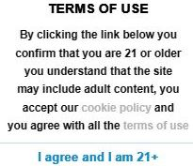
This is NOT a Male Detective,
Male FBI agent, or a Minor
Posting adult female ad
on an adult-only website
yet listing contact info
of a male officer
is “endeavoring to intercept” private communications
using impersonation

Slide 13



Officers are Pimping Women
Is “Lilly” a Geomorph or another Officer?
“Lilly” taken 2008
Pimped in 2018
by officer 100 miles away
2018 photo
Claims Lilly is not her
2018, arresting officers recognized “Lilly.”
Within days, the officer quit law enforcement.

Slide 14
Solicitation of a Minor
4 Variations of Impersonation
Using an imaginary person or geomorph, “Lilly”
Impersonating an adult, “Alex VA”
Impersonating a teen using teen’s phone for caller ID
FBI agent impersonating a mom pimping her “daughter”

Slide 15
Scenario #1 – Using an Imaginary Person
“Lilly” does not exist
“Lilly” is a composite using technology
  Female edited photo (geo-morph)
  – photo provides visual identification
  Male detective texts, provides history and life stories
  Uses entrapment
  Claims to be 14-years-old
“Lilly” has no birth certificate
Imaginary person cannot grant consent to interception

Slide 16
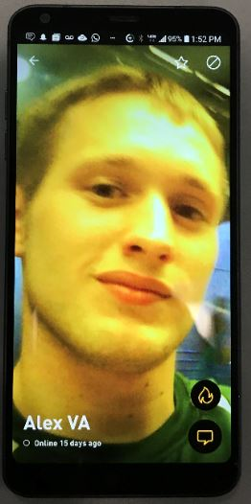
Scenario #2 – Impersonating an Adult Officer
On a Dating Site, Grindr
“Alex VA” is a composite of 3 people plus technology
  Det. BBB - texts, provides history and life stories
  Officer #2 – photo provides visual identification
    (not party to any conversation)
  Officer GGG – procured as youthful voice
  recorded in phone calls
3 birth certificates (3 people vs. 1 person)
No indication of age in profile (adult-only site)
Use entrapment
Later claim to be 14-years-old (5 o’clock shadow)
Grindr Profile

Slide 17
Scenario #3 - Impersonating a Teen
Parents reported suspicious texts from an adult to their teen
No criminal act committed by the adult, yet
Detective obtained written permission from parents
(e.g. FBI Form FD-1086 - Consent to Assume Online Identity)
Used teen’s phone to impersonate the teen and exchange texts
Used entrapment to cause a crime to be committed
Arrest warrant shows crime did not occur with actual youth:
“UNDERCOVER OPERATION ALLEGED 14-YEAR-OLD MALE”

Slide 18
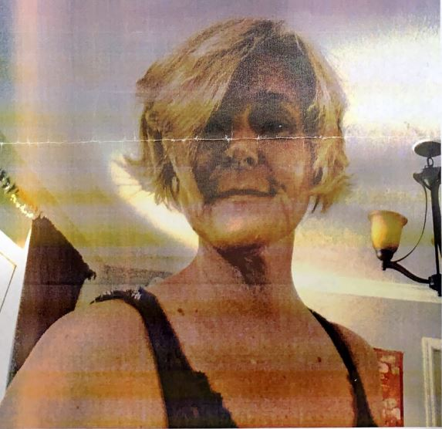
Scenario #4 – FBI Agent Impersonating a Mom
Posted ad on CraigsList Adult dating
Male FBI Agent - Bait and Switch
  “This is not about me!!! Mom with 12 yo daughter looking to gain new life experiences for my daughter”
Agent refuses to meet unless the fake daughter can tag along
Defendant researches conversation to find it was FAKE - wrong school, wrong dates, etc.
Entrapment -
U.S. v. Poehlman, 217 F.3d 692 (9th Cir. 2000)

Slide 19
Entrapment
Teach the Suspect how to Commit the Crime
Officer (“Lilly”):
  “I wish I could watch” “I want to see you”
  “You could db [Dropbox] a video too. Neck down or something.”
Defendant :
  “How do I send you the link?”
Officer:
  “you put the pic in your db [Dropbox]. Right click the pick [picture] and copy the link. Then paste it here.”

Slide 20
Definitions - Black’s Law Dictionary
“Impersonation” the act of impersonating someone
“Impostor” – one who pretends to be someone else to deceive others
“Persona” is an individual human being
  Wearing a disguise
  Using a fake name
  Speaking with a fake accent
An “imaginary person” is NOT a “persona”
“Persona” is used to deceive the Courts

Slide 21
Ashcroft v. Free Speech Coalition,
122 S. Ct 1389 (2002)
U.S. Supreme Court ruling:
Statutes can only be applied to images of real children,
not computer-generated children.
An image “is, or appears to be, of a minor” were ruled overbroad and may not even indicate exploitation of real children

Slide 22
Change: Federal Definition of “Minor”
Includes Cartoons and Adult Impostors
Sentencing Commission Amendment # 664, November 1, 2004
Change violates 28 U.S. Code § 994(a)
  “(1) Individual who had not attained the age of 18 years;
  (2) Individual whether fictitious or not, who a law enforcement officer represents to a participant
  (i) had not attained the age of 18 years, and
    (ii) could be provided to a participant for the purpose of engaging in sexually explicit conduct
  (3) an undercover law enforcement officer who represents to a participant that the officer had not attained the age of 18 years.”
  Overreach prohibited by overturning the Chevron Doctrine – Loper Bright Enterprises v. Raimondo and and Relentless Inc. v. Department of Commerce (Case Nos. 22-451 and 22-1219).

Slide 23
Suppression of Evidence - Ignored by Courts
18 U.S. Code § 2515
Impersonation is prohibited: 18 U.S. Code § 2511(2)(c) and (d)
  “… where such person is a party to the communication …”
Illegally obtained evidence is not allowed - fruit of the poisonous tree Silverthorne Lumber Co., Inc. v. United States (1920)
Wong Sun v. United States, 371 U.S. 471 (1963)
18 U.S. Code § 2515 states contents of communications cannot be received in evidence if obtained in violation of this chapter
Courts cherry-pick the law to get the outcome they want:
  Hence, Payne was a “person who was party to the communication[s]”
  … therefore did not criminally violate Code … Virginia v. Pick

Slide 24
** Executive Order 12333 Violations **
Impersonators and Imaginary People
cannot be a lawful party
to an electronic conversation because
they cannot be visibly present
to hold a similar oral conversation.
Imaginary person (investigative persona) is a thing
“Things” cannot be used to intercept communications
without a warrant

Slide 25
Violates: Federal ECPA Interception Law
18 U.S. Code § 2511
FBI Form FD-1086 - Consent to Assume Online Identity
No provision in the law makes it legal for officers
to intercept communications without a warrant
while impersonating someone else.
Written permission is a worthless piece of paper
(like written permission to rob the bank)
Photos seem to be used without consent

Slide 26
Recording Phone Calls and Videos
Det. BBB procured Officer GGG to provide a youthful voice of “Alex VA” on recorded phone calls
Det. BBB has special recording capability on his cell phone
Officer GGG used Det. BBB’s phone
  So Caller ID would match the number (identification)
  Use the recording capability
Recording live video also records audio

Slide 27
Endeavoring to Intercept
Placing a fake ad or fake profile is endeavoring to intercept
18 U.S. Code § 2511 Interception and disclosure of wire, oral, or electronic communications prohibited
1. Except as otherwise specifically provided in this chapter any person who:
…endeavors to intercept …any wire, electronic or oral communication;

Slide 28
Identity Theft
18 U.S. Code § 1028(a)(7), 1028A(a)(1)
“Whoever … knowingly … uses, without lawful authority, a means of identification of another person … in connection with, any unlawful activity that constitutes a violation of federal law or a felony under any applicable State law” violates 18 U.S. Code § 1028(a)(7).
“Means of identification” includes:
  Phone numbers
  Personal Accounts (email)
  Photos – shows unique physical representation of a person

Slide 29
Giglio Violation (like a Brady Violation)
Also Violates FAR Federal Regulations
Violates: User Agreements like Grindr (legal contract)
You hereby affirm and warrant that you are currently eighteen (18) years of age
You will NOT include images of any person under the age of eighteen
You will NOT impersonate any person
The Grindr Services are intended for the use by individuals, not governmental entities
“User" means any person or entity who uses an electronic communication service and is duly authorized by the provider of such service to engage in such use, 18 U.S. Code § 2517
Violates: 18 U.S. Code § 1030 the Federal Computer Fraud and Abuse Act
Notes:
Alex VA case was on Grindr. User had a reasonable expectation that Alex VA was an adult.

Slide 30
Legal: Authorization to Intercept
18 U.S. Code § 2511
Court authorization can only be granted for crimes like:
  Murder, kidnapping, extortion, bribery
  NOT solicitation or for possession of child pornography (See your state’s list)
In Virginia, only Virginia State Police can obtain authorization
(local officers do the investigations and sting operations)
Limited to 30 days, not 3 years
  15-year-old cartoon turned 18 (legal age),
  so officer and prosecutor backdated evidence by a year
  (Evidence tampering and Brady violation)

Slide 31
Federal Charge: 18 U.S. Code § 2422
Coercion and enticement
Suspect is erroneously charged with:
  (b) Whoever, using the mail or any facility or means of interstate or foreign commerce, … induces, entices, or coerces any individual who has not attained the age of 18 years, to engage in prostitution or any sexual activity for which any person can be charged with a criminal offense, …
  (Note: Individual does NOT mean a cartoon or impostor)
Yet, Officers violate the statute by convincing the suspect to travel so he can be arrested:
  (a) Whoever knowingly persuades, induces, entices, or coerces any individual to travel in interstate or foreign commerce, or in any Territory or Possession of the United States, to engage in prostitution, or in any sexual activity for which any person can be charged with a criminal offense, or attempts to do so, shall be fined under this title or imprisoned not more than 20 years, or both.

Slide 32
Wiretapping without a Warrant
Using Hash Codes as
Digital Fingerprints

Slide 33
Hash Codes Detect Transmission Errors
Hash code - A value obtained by applying a hash function to a block of data.
  Hash code calculated before transmission.
  Original hash code is shipped with the data (email) or
  stored in a bookkeeping file (some peer-to-peer)
  Hash code recalculated after transmission
  If hash codes differ, an error occurred and
  the block of bytes must be retransmitted
Buried in the network protocol – not seen by humans

Slide 34




Simple Transmission
Server
User
Requests Dog
Transmit pieces
“Partial file”
Dog is too big

Slide 35
Hash Codes Example
Detect transmission errors
Piece #1
Hash code = 12345
Piece #2
Hash code = 67890
Piece #3
Hash code = 98765

Slide 36
Problem
Law Enforcement use hash codes
to “fingerprint” content download
Hash code 12345 means head piece of the dog file.
Caution: different pieces could have the same calculated hash code (very rare)
Just like “5” can be calculated from 1+4=5 or 2+3=5.

Slide 37
Wiretapping Email
By Email Service Providers
(like Yahoo and Gmail) and NCMEC

Slide 38
Monitoring Communications
18 U.S. Code § 2511(2)(a)(i)
Not even service providers of publicly available, private communication systems can monitor content. Providers may only use a communication for that:
  “ … which is a necessary incident to the rendition of his service”.
  “… a provider of wire communication service to the public shall not utilize service observing or random monitoring except for mechanical or service quality control checks.”
  Telephone companies cannot monitor phone calls
  Email service providers cannot monitor emails
  BitTorrent and Freenet administrators cannot monitor file transfers
Illegal interception of content (hash codes) 18 U.S. Code § 2511
Law enforcement cannot monitor private communications
WITHOUT A WARRANT

Slide 39
Reporting Requirements
Honor 4th Amendment Law
18 U.S. Code § 2258A – Reporting requirements of providers
(f) Protection of Privacy.
- Nothing in this section shall be construed to require a provider to –
Monitor any user, subscriber, or customer of that provider;
Monitor the content of any communication of any person
described in paragraph (1); or
(3) Affirmatively search, screen, or scan for facts or circumstances
described in sections (a) [Duty to Report] and (b) [Contents of Report].

Slide 40
Yahoo Files NCMEC Reports for a “Hash Match”
Hash codes (alone) are used by Yahoo to detect transmission errors
Yahoo has no knowledge of “good” or “bad” hash codes
“Hash Match” implies Federal Agency provides
a list of hash codes “of interest” to Yahoo
Yahoo checks hash code of every email and attachment against the list
“Hash Match” triggers a NCMEC report (computer-to-computer)
  NCMEC - National Center for Missing and Exploited Children
Need to prove NCMEC and Yahoo are agents of the Federal Government
  Chartered and funded by the Federal Government, 34 U.S. Code § 11293

Slide 41
Researched User without a Warrant
Yahoo personnel inspected emails, examined “non-reported images”
Yahoo personnel used non-Yahoo tools to research their user:
TLO, Spokeo, Facebook, LinkedIn, Instagram, Twitter
NCMEC researched personal info: TLO, NSOR, Google
  WHOIS, Maxmind – converts IP addresses to geographic info law
  Traceroute – gets routing info
NO pen register warrant for IP address, routing, or decoding user info

Slide 42
Other Products
Microsoft’s PhotoDNA - Uses AI to handles “fuzzy” matches
  Legal for public posts
  Illegal for private communication or private backup storage
  without a warrant
Apple’s NeuralHash – proprietary hash code algorithm
  Provided algorithm to NCMEC to get a hash code list “of interest”
  Apple monitored data uploaded to the iCloud
  Pulled program in 2022 for privacy reasons

Slide 43
Estimates
Reports filed with NCMEC per day
Subtract Report numbers from 2 reports = 349,735 reports
Subtract Time of Reports = 204.8 hours
41,000 reports per day
Most are Computer-to-Computer Filings (Yahoo-to-NCMEC)
(2023) U.S. sent 9.8 billion of 347.3 billion emails worldwide for
2.8% of worldwide emails*
(2021) 2.8% of 319.6 billion emails worldwide = 9 billion U.S. emails
9,000,000,000 emails per day = 1 report per 220,000 emails
41,000 reports
*Statista. (2017). Daily Number of e-mails Worldwide 2023 | Statista. Statista; Statista. https://www.statista.com/statistics/456500/daily-number-of-e-mails-worldwide/

Slide 44
Google and NCMEC
870,319 NCMEC reports files in 2021*
2,385 reports per day 5.8% of 41,000
17 companies the size of Google are needed to file 41,000 reports per day.
Google identifies CSAM, creates hash codes, sends to NCMEC’s database
Google contributed 2,468,832 hashes “of interest” to NCMEC*
*Google Transparency Report. (n.d.). Transparencyreport.google.com. Retrieved January 14, 2024, from https://transparencyreport.google.com/child-sexual-abuse-material/reporting?hl=en&lu=total_cybertipline_reports&total_content_reported=period:2021H1&total_cybertipline_reports=period:2021H1

Slide 45
Google Terms of Use
Phone Companies Cannot Do This!!!
We also collect the content you create, upload, or receive from others when using our services. This includes things like email you write and receive, photos and videos you save, docs and spreadsheets you create, and comments you make on YouTube videos. 1
We use information to help improve the safety and reliability of our services. This includes detecting, preventing, and responding to fraud, abuse, security risks, and technical issues that could harm Google, our users, or the public. 1
And we analyze your content to help us detect abuse such as spam, malware, and illegal content. 1
We may review content to determine whether it is illegal or violates our Program Policies, and we may remove or refuse to display content that we reasonably believe violates our policies or the law. But that does not necessarily mean that we review content, so please don’t assume that we do. 2
1 Google. (2022). Privacy Policy – Privacy & Terms – Google. Google.com; Privacy & Terms – Google. https://policies.google.com/privacy?hl=en-US
2 Google Drive Terms of Service. (2018). Google.com. https://www.google.com/drive/terms-of-service/
OK for public posts, too broad for private communications

Slide 46
Family, Girlfriend, or Unrequested Photos
Porn emailed to targets as a take-down or hit job, .e.g. my acquaintance’s husband
No exception for private photos of family members
No exception for photos of 16-year-old girlfriend
where the defendant was legally having sex
Men are spending decades in prison for FAMILY or GIRLFRIEND photos
Stack charges to force a plea deal – sign or face up to 900 years in prison

Slide 47
Wiretapping
Peer-to-Peer Networks
Via Customized Software
Contracted by the Government
Starting in January, 2009

Slide 48
Wiretapping
BitTorrent Products
Shareaza, eMule, eDonkey, etc.

Slide 49
What is a Peer-to-Peer File Service?
Transfers large files such as videos, music
Free
Layered on BitTorrent protocol
Service provider copies file pieces from your neighbor
instead of a master copy across the country (less internet traffic)
Windows 10 uses the BitTorrent protocol to deliver software updates (default)

Slide 50
Scenario from Officer’s Testimony
While operating using an undercover operation, using law enforcement tools, I saw an IP address that had been notified by our tools to have known or suspected child pornography on its system.
I then downloaded it, started a download with another program called Shareaza LE. It’s only for law enforcement. And I was able to get to the files once the investigation started.
Once I was able to download those files, I utilized the system to obtain records to identify the subscriber to the IP address or the subscriber to the Internet service provider.
I then contacted the local jurisdiction that the Internet service provider had and coordinated from there.

Slide 51
Questioning the Officer
Q: … other than that automated computer database that you described, … what brought your attention to that IP address?
A: … the IP address was seen with known or suspected child pornography
Q: By whom?
A: By the database that we use.
Q: And How did you know the files that you encountered were related to child exploitation?
A: With the names that attached to them, along with we had similar files of the same in our core system.

Slide 52
Questioning the Officer, cont.
Q: And so prior to getting the search warrant, you had a partial download.
A: Yes ma’am
Q: – from this IP address?
A: Yes ma’am
Q: ... when did the download of the two complete files occur?
… Was it before or after the execution of the search warrant?
A: It was before.

Slide 53
Scenario Questions
Where did the IP address come from?
Why was this IP address selected for notification?
How did the officer “access” a password-protected computer?
How did the officer “download” files from the computer?
What “system” did the officer use to identify the suspect?
How did the officer figure out which jurisdiction was “local”?
Where are the warrants?

Slide 54
Unintended Confessions
(Actions without a Warrant):
ICAC has a database inventorying content downloaded to private computers at IP addresses
“Access” means break in.
“Download” means steal a copy.
“Core System” includes a LE-only library of child porn with hash codes
“Core System” means submit administrative subpoenas
based on illegally obtained data vs. getting a warrant
“Local jurisdiction” means he geo-located the suspect to a locality
“Law enforcement only” means not publicly available.

Slide 55
DNI: Publicly Available vs. Needing a Warrant
The information must be available to any member of the general public.
    Office of Director of National Intelligence (DNI), Civil Liberties and Privacy Guidance for Intelligence Community Professionals: Properly Obtaining and Using Publicly Available Information (July 2011)
Information that has been published or broadcast for public consumption, is available on request to the public, is accessible on-line or otherwise to the public, is available to the public by subscription or purchase, could be seen or heard by any casual observer, is made available at a meeting open to the public, or is obtained by visiting any place or attending any event that is open to the public.
DoDM 5240.01, August 8, 2016

Slide 56
I Reverse Engineered the LE Tools
Analyze officer testimony to see what data is extracted
Analyze BitTorrent Design Documents to see where the data comes from

Slide 57
Bookkeeping File #1
Torrent File - Table of Contents
File name
List of all the pieces
Hash codes for each piece
  (Indications hash codes are computed for EVERYTHING on a computer)
Web address for Tracker file

Slide 58
Bookkeeping File #2
Tracker File - Stores Transactional Records
Tracker File (P2P)
  Hash codes
  IP addresses which downloaded each piece
Other information:
  Date / time of each download
  Subscriber information

Slide 59
Accessing Stored Communications
18 U.S. Code § 2701
Unlawful access to stored communications
  (a) Offense.— … whoever—
    (1) intentionally accesses without authorization a facility through which an electronic communication service is provided; or
    (2) intentionally exceeds an authorization to access that facility; and thereby obtains, alters, or prevents authorized access to a wire or electronic communication while it is in electronic storage in such system shall be punished as provided in subsection (b) of this section
Breaking into the bookkeeping and taking transactional records
Breaking into a user’s computer and downloading file pieces
Inventorying content of person’s private computer from file listings

Slide 60
Wiretapping Tool: Torrential Downpour
(or similar Law Enforcement only tool)
Wiretaps BitTorrent Networks
Breaks into the bookkeeping files
Steals the transactional records
Loads IP addresses and hash codes (content)
into the ICAC Cops Database
Run periodically
New IP addresses generate an alert

Slide 61
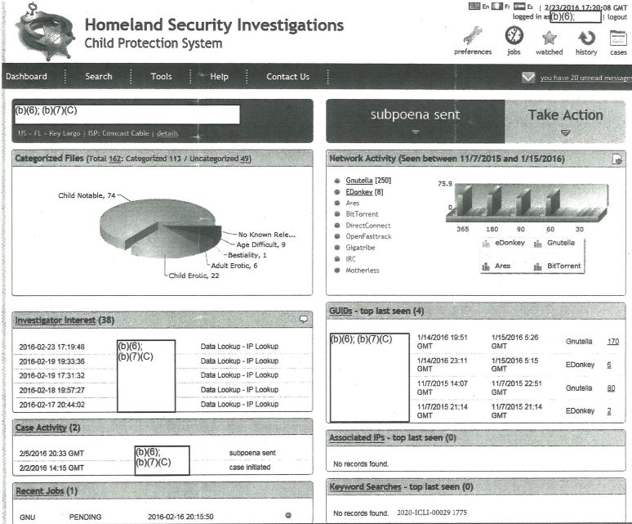
Homeland
Security’s
Wiretapping
Software
Program
Confirms
Officer’s
Testimony

Slide 62
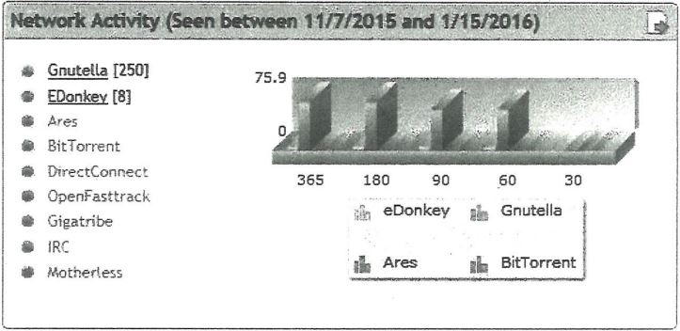
Pick Network You Want to Wiretap
(without a warrant)

Slide 63
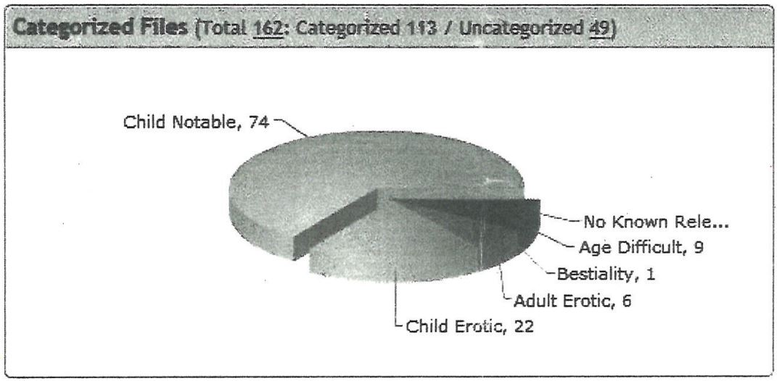
Intercept Content for a Pie Chart
Note: ANY topic can be flagged “of interest”
Legal?
Content

Slide 64
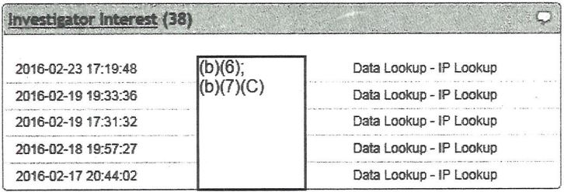
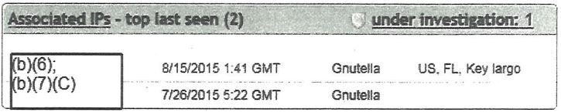
IP Addresses Intercepted and Geo-Located
IP addresses

Slide 65
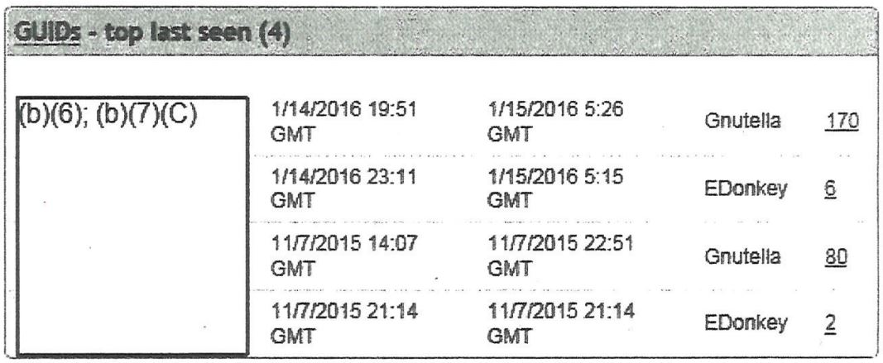
User GUIDs Intercepted
(Globally Unique Identifier)
Note the Date and Time Stamps

Slide 66
ICAC Cops Database
of Intercepted Content and IP Addresses
Obtained WITHOUT A WARRANT
Bookkeeping files are used to inventorying content downloaded to people’s private computers:
  Filenames
  IP addresses
  Dates and times of file transfers
  Subscriber information
  Hash codes – “fingerprint” what was downloaded - CONTENT

Slide 67
Remote Search of
Defendant’s Private Computer
WITHOUT a Warrant

Slide 68
DOJ: Publicly Available vs. Needing a Warrant
Location of Evidence determines if a warrant is required
  Department of Justice, National Institute of Justice. Report on Investigations Involving the Internet and Computer Networks (January 2007)
  Is government action involved? YES
  Does the person affected have a reasonable expectation of privacy in the place or thing being searched? YES
Tracker file – located on some computer on the World Wide Web
File Pieces (partial file) – user’s private, password protected computer

Slide 69
Shareaza-LE Capabilities
Shareaza-LE means “Law Enforcement” only
Skeleton key for computers with BitTorrent peer-to-peer programs
Breaks into a password protected private computer
via a back-door port reserved for Shareaza (or similar tool)
Allows two-way access
  Officers can download file listings and file content
  Might be possible to search the entire computer, depending on protections
  Officers can plant evidence
    (Suspicions about files dated after the arrest, files mailed to suspect, etc.)

Slide 70
Computer Contaminant
(states’ law)
South Carolina
SC Code § 16-16-10
  "Computer contaminant" means a computer program designed to … allow unauthorized access to … a computer. ..
SC Code § 16-16-20 Computer crime offenses; penalties
  (1) It is unlawful for a person to wilfully … introduce a computer contaminant into that computer, computer system, computer program, or computer network.

Slide 71
Computer Trespass
(states’ law)
Virginia
Va. Code § 18.2-152. Computer trespass; penalty
…
  6. Use a computer or computer network to make or cause to be made an unauthorized copy, in any form, including, but not limited to, any printed or electronic form of computer data, computer programs or computer software residing in, communicated by, or produced by a computer or computer network;

Slide 72
Other Problems
Mistakes downloaded can NEVER be corrected
Child porn pieces can be put into innocent files
No control over equipment – taken home or carried to Maryland
No log documenting officer’s use of tools
  No requirement to obtain a warrant prior to use
  No tracking of officer’s name, time, commands entered
This log should be produced at every trial

Slide 73
Wiretapping
Freenet

Slide 74
Normal Freenet
Store a file – disperse pieces up to 18 computer hops away
Retrieve a file – request pieces
Intermediate node
  Transports pieces
  Temporary electronic storage as pieces hop from one computer to another
Computer owner does not know what files are stored on
or transported through his computer.

Slide 75
Customized LE Freenet
Does not store files
Does not retrieve files or forward requests
  Note: Storing or retrieving files would plant CP on innocent computers
Captures all requests and analyzes them
  Note: There is no data or CP in a request
All it does is suck data off the network and report it to law enforcement

Slide 76
Customized Freenet is a Wiretap Tool
Modified law-enforcement-only version of Freenet software
Taps into Freenet file transfer system – without a warrant
Monitors network traffic carried over the internet wire
Extracts and logs (~500,000 per day, per computer):
  IP addresses (requires a pen register warrant)
  Number of peers
  Unique IDs
  Date/time of request
  Hash codes (converted to content)
Forwarded nightly to “Black Ice” – the mothership

Slide 77
Customized Freenet Info Forwarded Nightly to “Black Ice”
“Black Ice” is the mothership
Database #1 KeyMaster - tracks all manifest keys, split keys, and hashes
Database #2 – Tracks Freenet IP Address / Ports, irrespective of CP
Converts hash codes into “content”, catalogs hash codes by file, priority
Used without a warrant

Slide 78
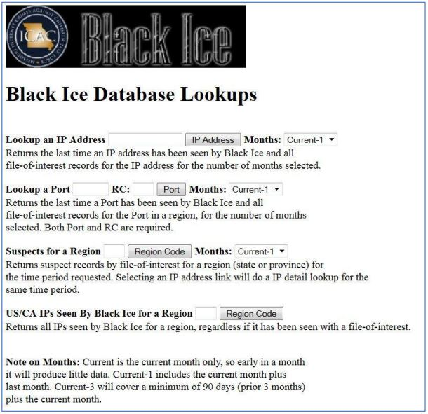
Black Ice Queries
By geographic region
By IP address
Finds pieces passing THROUGH a node
IP addresses from other sources can be used to flag Freenet “crimes”

Slide 79
Monitoring Communications
18 U.S. Code § 2511(2)(a)(i)
Not even service providers of publicly available, private communication systems can monitor content
  “… a provider of wire communication service to the public shall not utilize service observing or random monitoring except for mechanical or service quality control checks.”
  Telephone companies cannot monitor phone calls
  Freenet administrators cannot monitor file transfers
Illegal interception of content (hash codes) 18 U.S. Code § 2511
Law enforcement cannot monitor private communications
WITHOUT A WARRANT

Slide 80
Lack of Intent to Commit a Crime
User Agreements (Freenet) state: user has no control over what is put on their computer
“Unlike other peer-to-peer networks, you as a user have little or no control over what is stored in your datastore. Instead, files are kept or deleted depending on how popular they are. This allows Freenet to be censorship-resistant. There is no “delete file” operation.”
  Freenetproject.org, Freenet Documentation, https://freenetproject.org/pages/documentation.html
  Accessed January 2, 2023
Notes:
Alex VA case was on Grindr. User had a reasonable expectation that Alex VA was an adult.

Slide 81
Unmasking Identity of
Anonymous Online Suspects

Slide 82
Improper Methods are Being Used
to Unmask Identities of Suspects
Illegally intercepted chat content: (18 U.S. Code § 2511)
Account names, Email address, Name, Personal identifying information
No pen register warrant to: (18 U.S. Code § 3121)
Decode Bookkeeping files of peer-to-peer networks
Obtain hidden IP addresses or account names
Use commercial products (Dropbox) to get IP addresses
Administrative subpoenas used to unmask owner’s identity,
not warrants (18 U.S. Code § 2703)

Slide 83
Pen Register / Trap and Trace
18 U.S. Code § 3121, 3127
3121(a) … No person may install or use a pen register or
a trap and trace device without first obtaining a court order …
3127: "Pen Register" means a device or process that records or decodes dialing, routing, addressing or signaling information transmitted by an instrument or facility from which a wire or electronic communication is transmitted; … (Where do messages go?)
“Trap and Trace Device" … (Where do messages come from?)
Facility - something that is built, installed, or established to serve a particular purpose, Webster’s Dictionary
Metatdata – defined in DoDM S-5240-01.A

Slide 84
Administrative Subpoenas
vs. a Warrant
Administrative subpoena:
  18 U.S. Code § 2703(c)(2) A provider … shall disclose to a governmental entity the:
  (name, address, telephone number, subscriber identity, network address)
  of a subscriber or a customer …
The law does NOT say the reverse:
  Given an (email address, phone number, or network address),
  the service provider shall provide the identity of the subscriber or customer.

Slide 85
Precedential Court Cases
Warrant required to trace ownership of a phone number
Smith v. Maryland, 442 US 735 (1979)
Warrant required to trace ownership of an email address
McVeigh v. Cohen, 983 F. Supp. 215 (D.D.C. 1998)
Warrant required to trace cell towers used (geo-location)
Carpenter v. United States, No. 16-402, 585 U.S. _ (2018).
Broad Geo-fence warrants are unconstitutional (geo-location)
United States v. Chatrie, CRIMINAL 3:19cr130 (E.D. Va. Mar. 3, 2022)
ICAC officers typically only get administrative subpoenas, not warrants

Slide 86
The Right to Remain Anonymous
Apps intentionally mask a user’s true email address, IP address, and ownership
U.S. v. McIntyre, 582 F.2d 1221 (9th Cir. 1978).
Talley v. California, 362 U.S. 60 (1960).
Signature Mgmt. Team, LLC v. Doe, 323 F. Supp. 3d 954 (E.D. Mich. 2018).
Any “process” to obtain a hidden address for the purpose of unmasking the identity of an anonymous person requires a warrant

Slide 87
Planting
Electronic Evidence on
Cell Phones and Other Devices
From Stephen Coker, Digital Forensic Expert
CokerForensics.com

Slide 88
Planting Evidence on Computers
Disconnect computer from the internet
Set the clock’s date and time back to the time the “crime” occurred
Copy files onto the computer – timestamped with the fake time
Perform Internet searches
Send emails to yourself
Evidence planted

Slide 89
Background Info: Purchase a New Phone
User wants address list and text messages transferred to new phone
Clerk connects old phone to their computer
Backups phone to the computer
Disconnects old phone
Connects new phone
Copies address list and text messages to new phone

Slide 90
Planting Evidence on Phones
Connect defendant’s phone to officer’s computer
Backups defendant’s phone to computer
Disconnect defendant’s phone, disconnect computer from the internet
Set computer clock to the time they want the “crime” to have occurred
Plant evidence in “phone” backup - time-tagged with fake clock
Possible phone emulator exists to allow officer to operate the “phone”
Reconnect defendant’s phone
Erase defendant’s phone
Restore contaminated backup to defendant’s phone

Slide 91
Planting Evidence Leaves Traces
According to Stephen Coker, Digital Forensic Expert
CokerForensics.com
Personalized background photo is gone
Files dated AFTER arrest
Phone connected to internet AFTER arrest
Phones crash – crash log
SqlLite trace logs show clock rolling backwards
  Clock set back to time BEFORE the phone was manufactured
  Geographic traces show user driving to a job while simultaneously in another city downloading child porn
TAR (compressed collection of file to plant) dated AFTER arrest, decompressed version of planted files dated BEFORE arrest

Slide 92
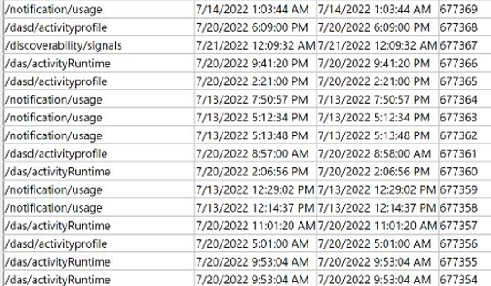
Traces
Check Dates and Times
Sort by
Read
Time
Increases

Slide 93
Summary
Cost and Impact

Slide 94
Citizen’s Fourth Amendment Rights
From what I have seen,
Overseas Terrorists
have more protection of their privacy rights
than U.S. Citizens
FBI and Law Enforcement are conducting COMINT operations
Against U.S. citizens, without a warrant.

Slide 95
COMINT Operations against US Citizens
Communications Intelligence – information derived from foreign communications by other than the intended recipients.
… passed by radio, wire, or electromagnetic means ...
Collection comprises search, intercept, and direction finding.
Processing comprises range estimation, transmitter/operator identification, signal analysis, traffic analysis, cryptanalysis, decryption, study of plain text, and fusion of these processes, and the reporting of results.
NSCID-6, National Security Council Intelligence Directive No. 6

Slide 96
Innocent are Serving Time
Whose fingers are on the keyboard is irrelevant,
owner of IP address is prosecuted
Innocent includes:
  Roommates – Lopez
  Fathers, uncles – “somebody has to go to jail”
  Neighbor with the only internet in town
  Computer repairman - closed private trial (Texas federal)
    Motion to stop his testimony because it was “gibberish” was sustained,
    to prevent him from explaining to the jury what happened (according to Snider)

Slide 97
Forcing Plea Deals
Stack charges so defendants face up to 900 years
(accidentally download one file chopped into 20,000 pieces)
95% take plea deal
Those that go to trial face “trail penalty”
(3-4 times more years in prison)
Prosecutor: Sign the plea deal or get 100 more charges
Judge: I’m up for election, so sign a plea deal. Otherwise I’ll nail you.

Slide 98
ICAC Illegal Prosecutions since 1998
About 180,000 people nationwide
have been manufactured into criminals
Or officers criminally wiretapped
private communications
180,000 should NOT be on the Sex Offender Registry

Slide 99
Money
ICAC Money 1998-2023
$973,047,362 in federal grants 34 U.S. Code § 21117
State / local grants match federal
State money - $130 per day to incarcerate a person * 120 people
  = $5,600,000 per year given to Stafford County, VA
Donations – from whom???
Rumors of $5,000 officer bonus per person put on the registry
Multi-BILLION dollar enterprise since 1998
  (Including cost of incarceration, attorneys, court fees, lost income, etc.)

Slide 100
Questions?
Notes:
49:00

